Slide 1


©TruePBL. All rights reserved.

Slide 2

©TruePBL. All rights reserved.

Slide 3
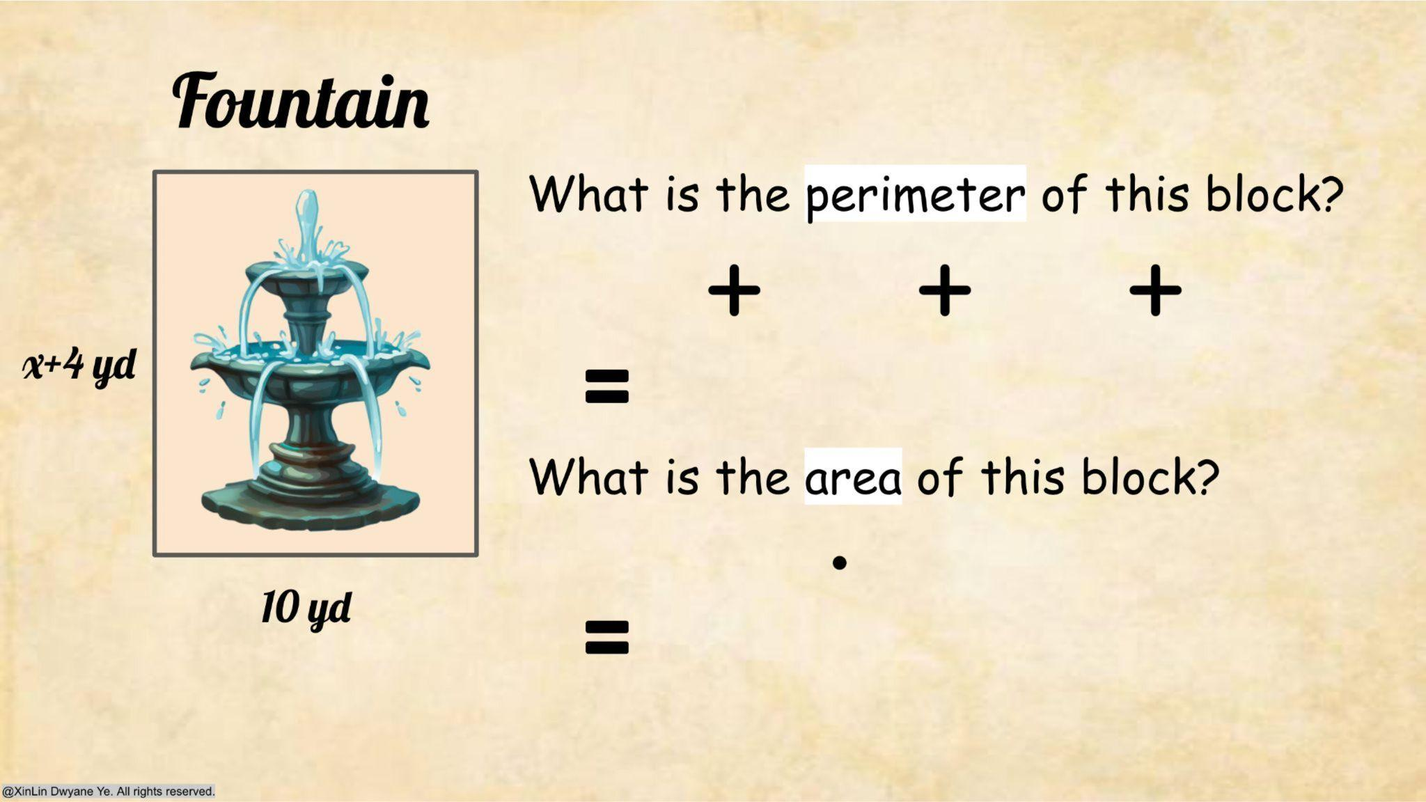

©TruePBL. All rights reserved.

Slide 4
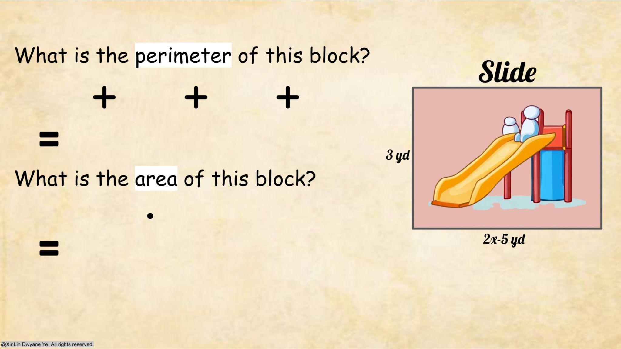
©TruePBL. All rights reserved.

Slide 5
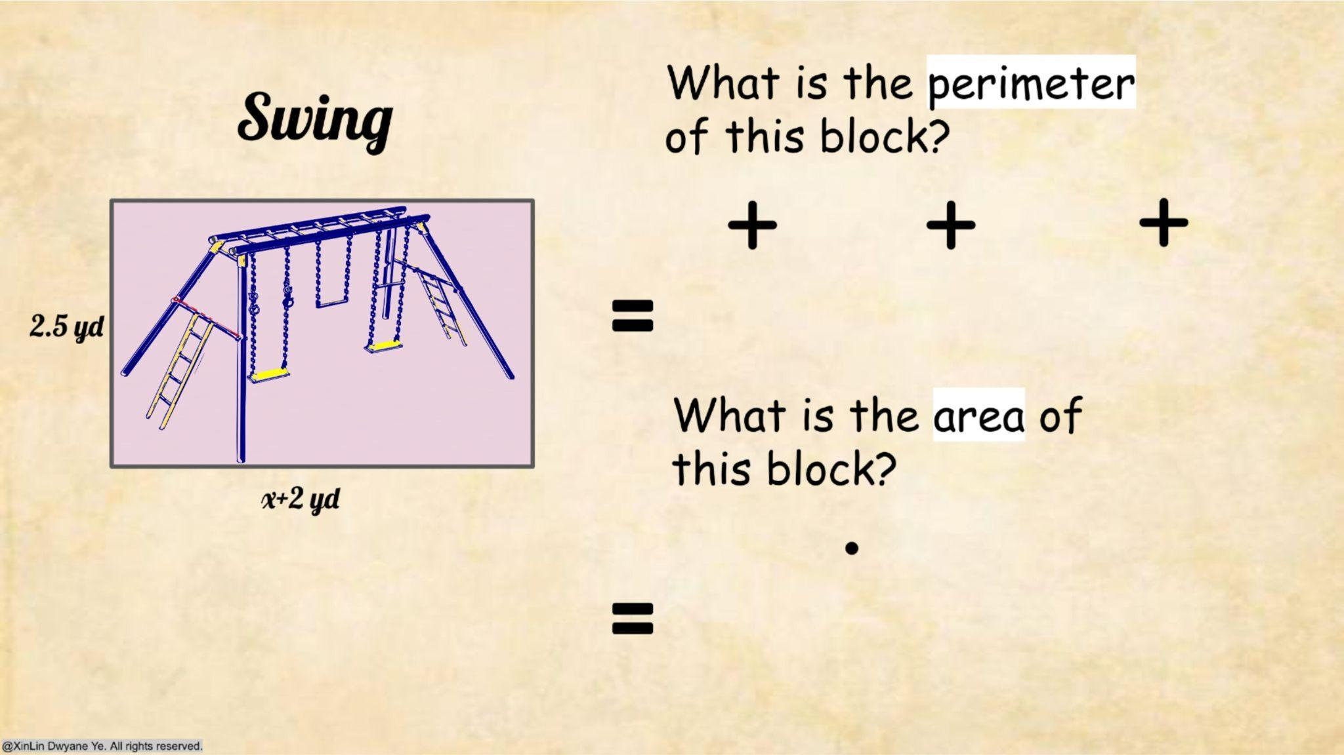
©TruePBL. All rights reserved.

Slide 6
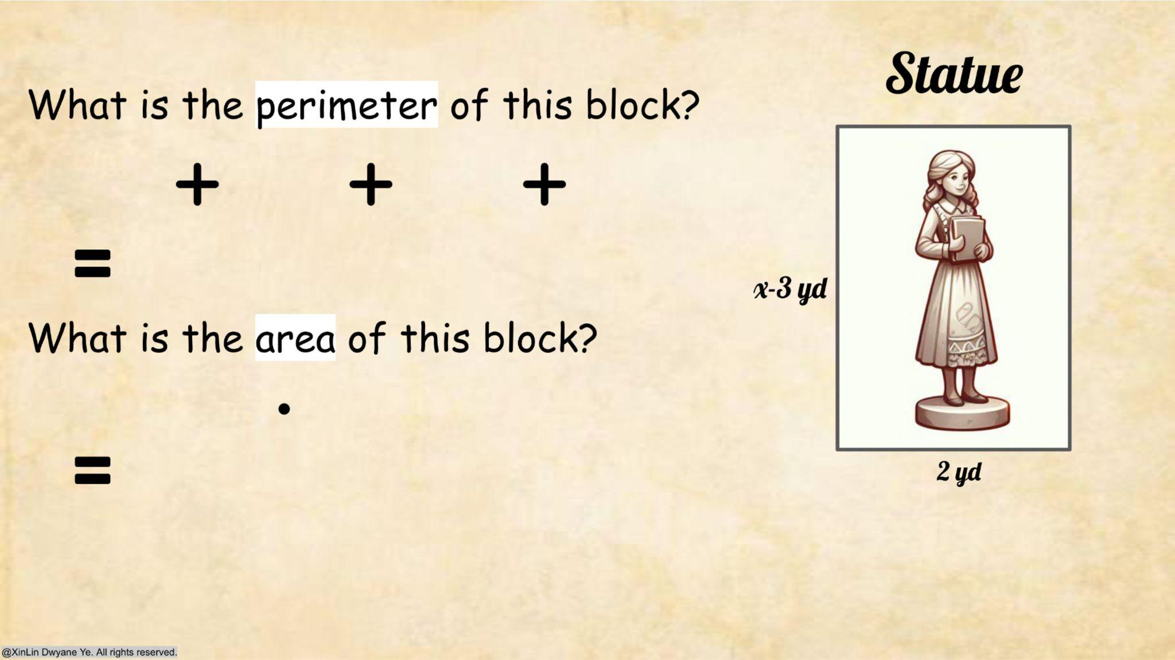
©TruePBL. All rights reserved.

Slide 7
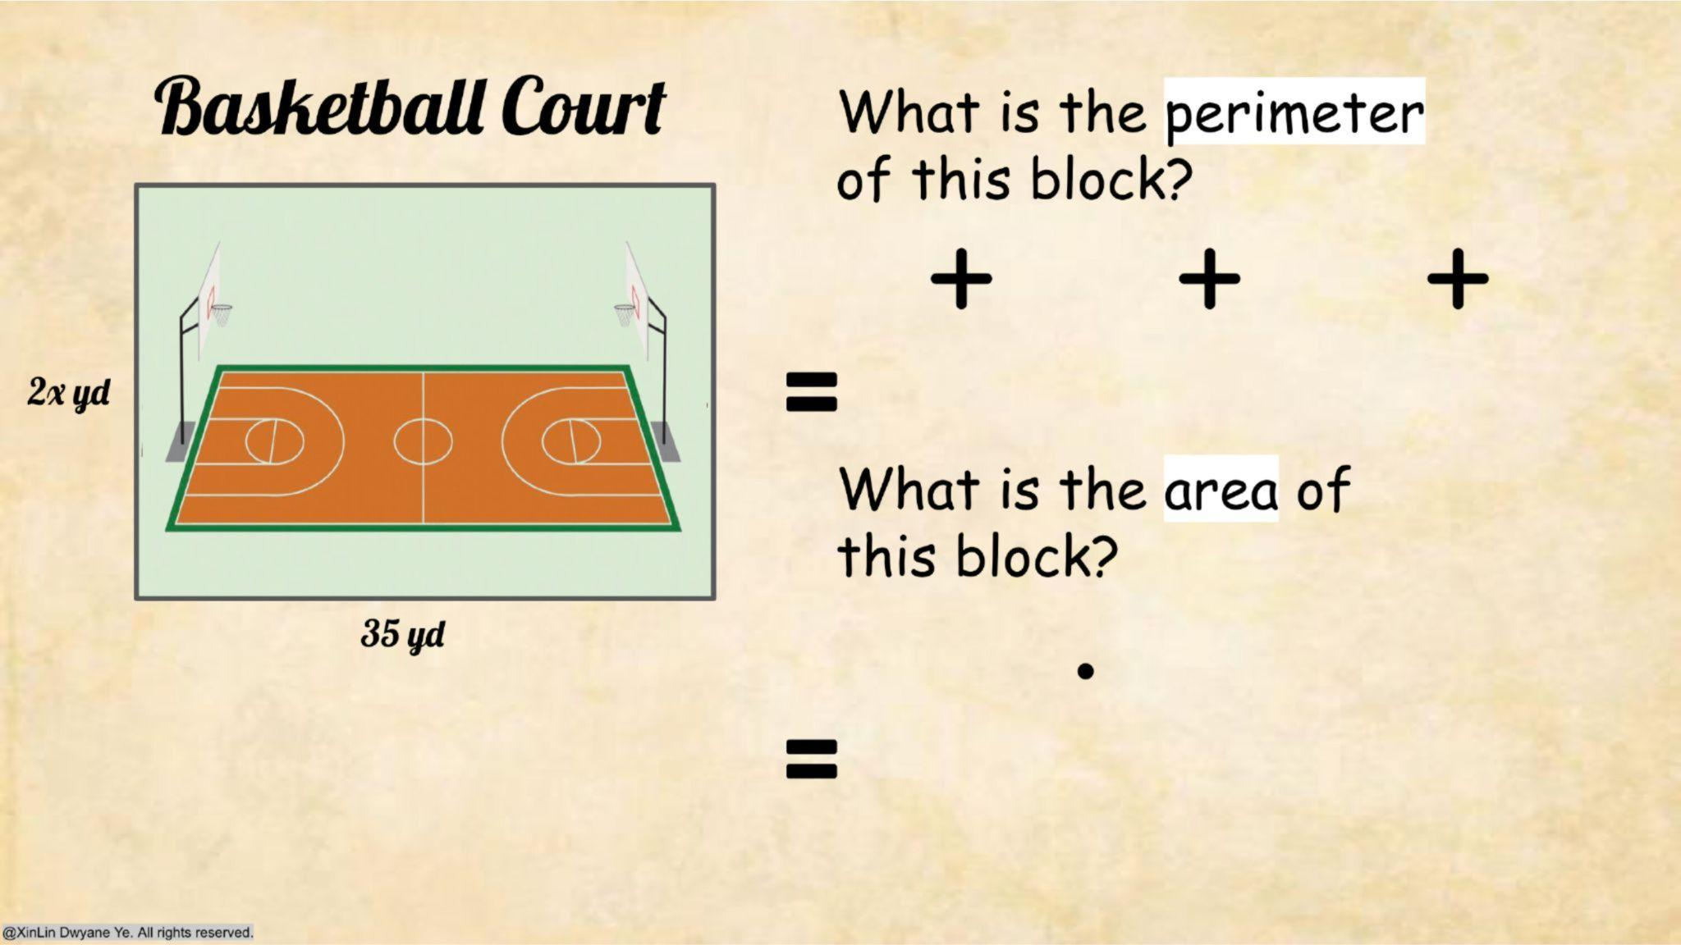
©TruePBL. All rights reserved.

Slide 8
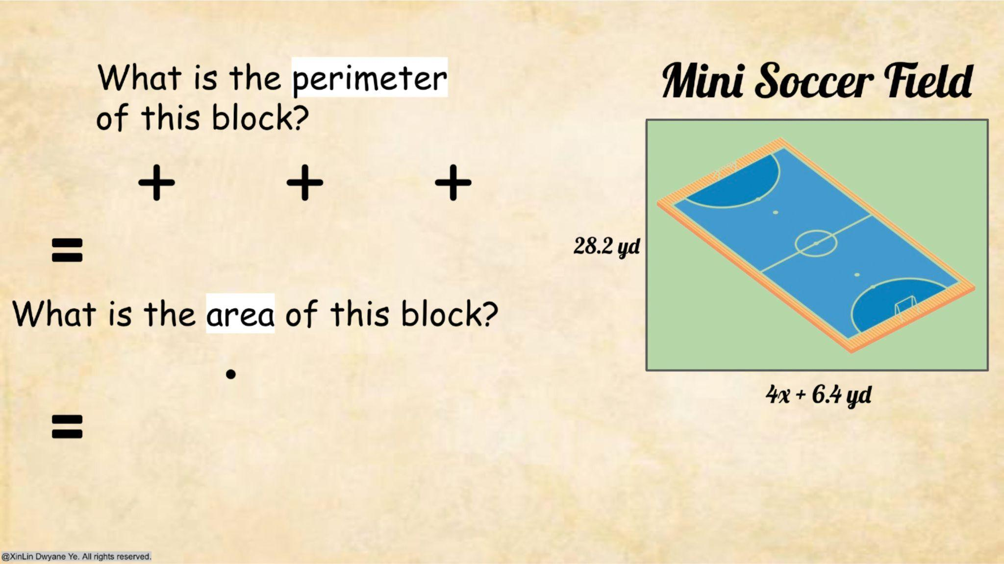
©TruePBL. All rights reserved.

Slide 9
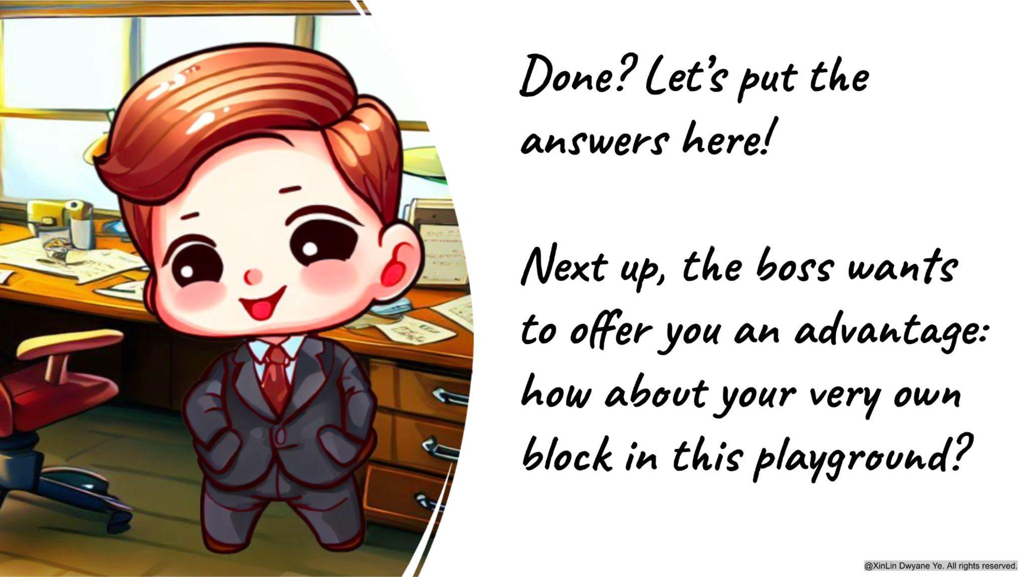
©TruePBL. All rights reserved.

Slide 10
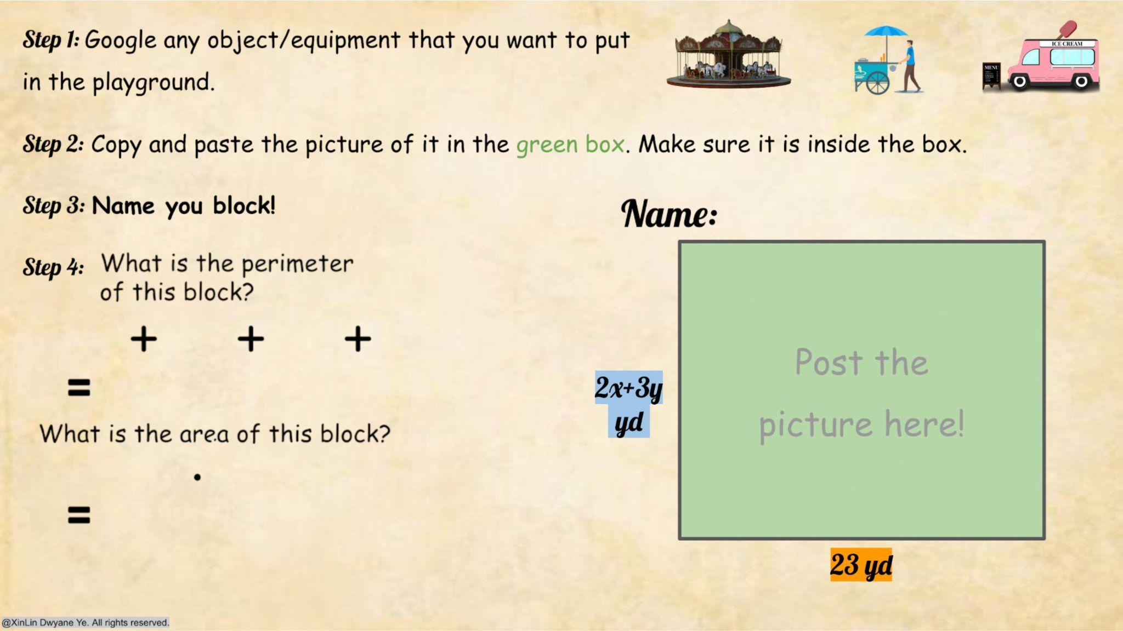
©TruePBL. All rights reserved.

Slide 11
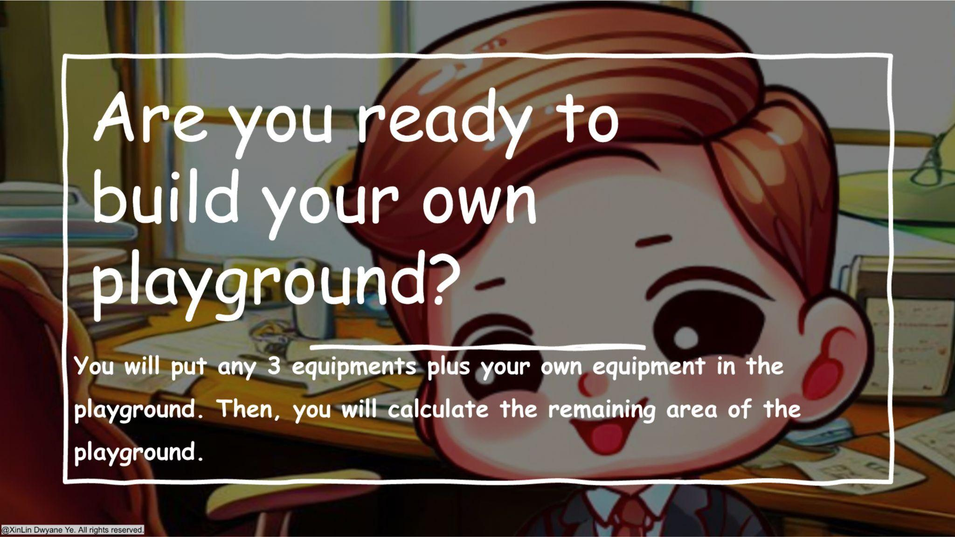
©TruePBL. All rights reserved.

Slide 12
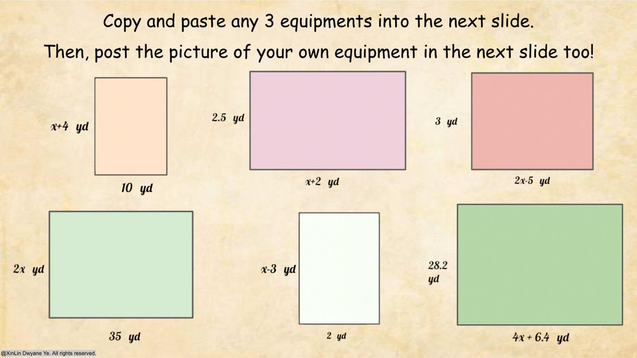






©TruePBL. All rights reserved.

Slide 13

©TruePBL. All rights reserved.

Slide 14
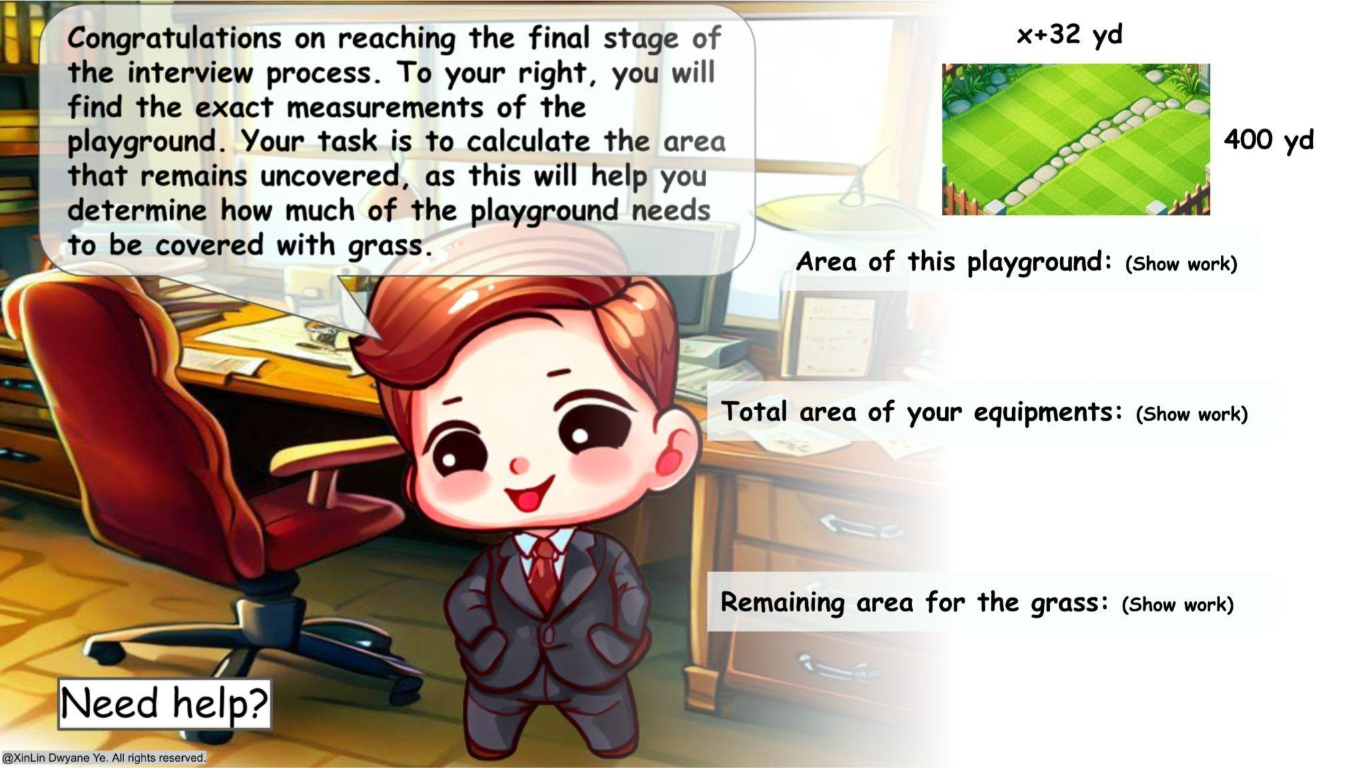
©TruePBL. All rights reserved.

